Slide 1
MAD BANK You are richer than you think
By
Hari Hara Surya Teja.V 1896521
Palanchi Shiva 1897051
Akhil Jogiparthi 1896640
Vedanth Erukulla 1898334

Slide 2
Introduction
In the past few years, modern technology has become accessible to society at large.
More and more people are relying on technology to make their life easy.
A smart phone is such a device which can be used by people irrespective their age.
By creating a bank application we are simplifying the banking experience of a user.

Slide 3
Purpose of the application
It provides remote access to financial transactions using mobile devices such as smart phone or a tablet.
Mobile banking is usually available on a 24-hour basis.
By using banking applications we can reduce the need for customers to visit a bank branch for non-cash withdrawal and deposit transactions.

Slide 4
some Features of the application

Slide 5
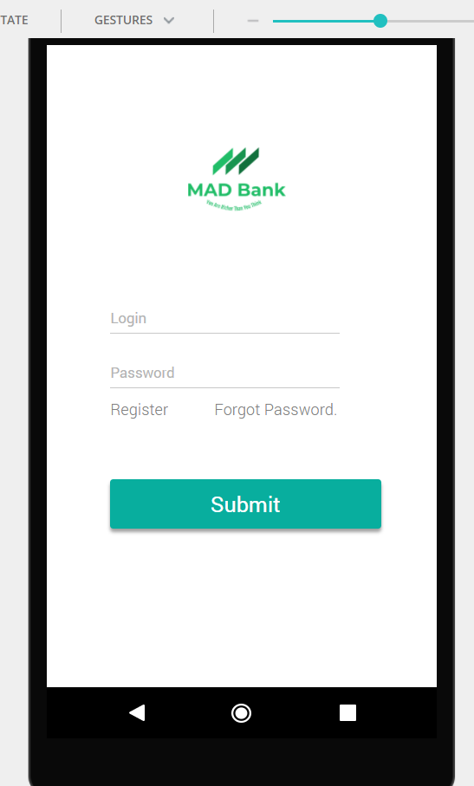
Login Screen
Using the login page the users can access their account.
If the user forgets their password they can access it by clicking the forgot password option and by following the instructions sent to their email.
Here the user can create their online account and can complete the registration by submitting the required documents to the bank.

Slide 6
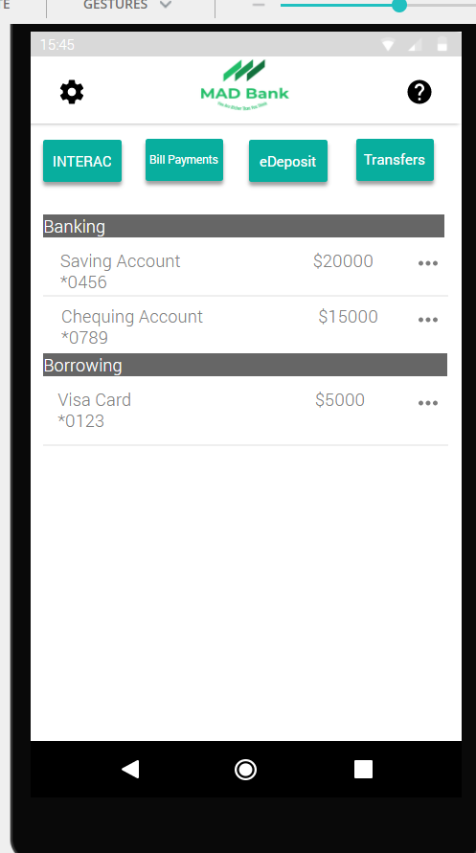
Main page
In this screen the user can send money by using the interac option
The user can keep track of their expenses by checking their statements.
And can also make bill payments.

Slide 7
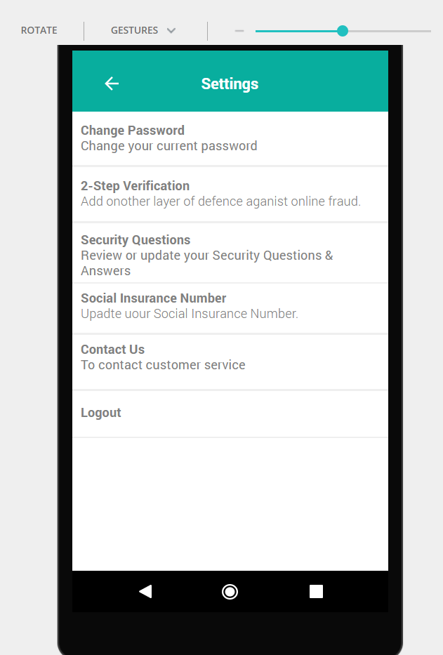
Settings page
In the settings screen the user can change their password, and can also add additional security to their account by enabling 2-step verification.
User can also edit the security questions and their personal info.

Slide 8
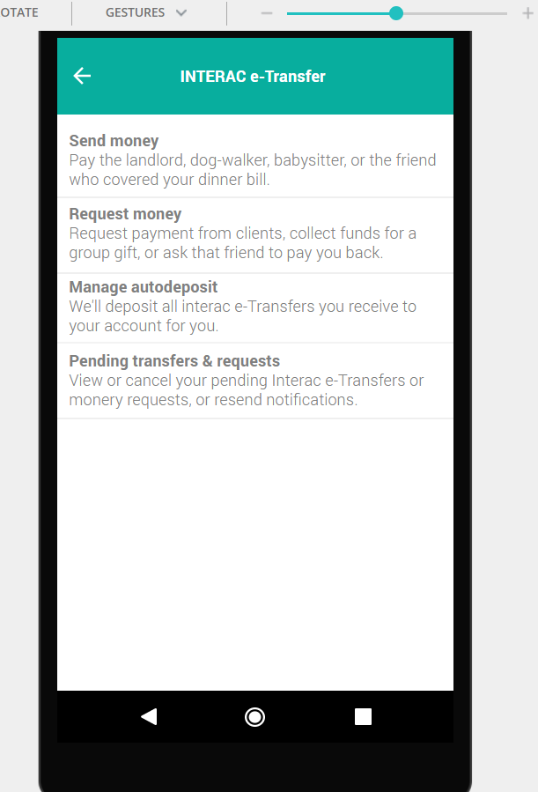
Interac page
In this screen the user has the option to send and request money.
Here the user can also manage their auto-deposit settings and their pending transfers and requests.

Slide 9
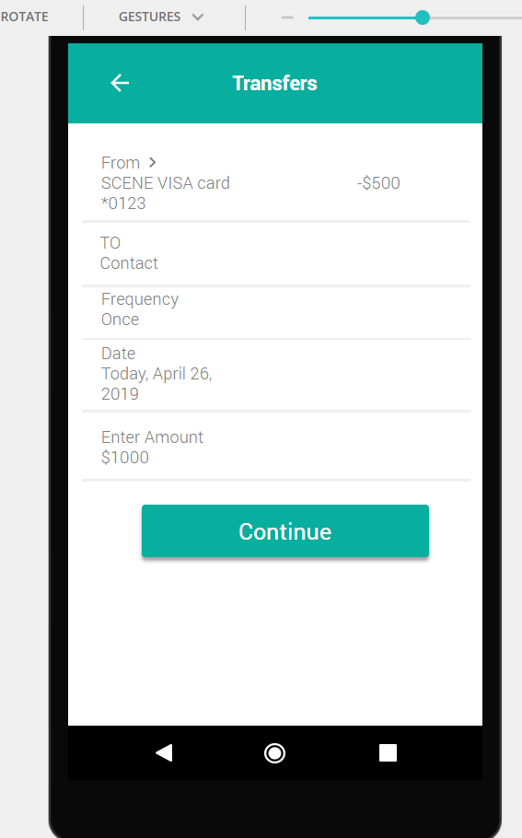
transfers page
In this screen the user can transfer money for bill payments, or from one account to another(i.e. from savings to chequing and vice versa ).
Here the user is given the flexibility to select the account from which the amount will be transferred.

Slide 10
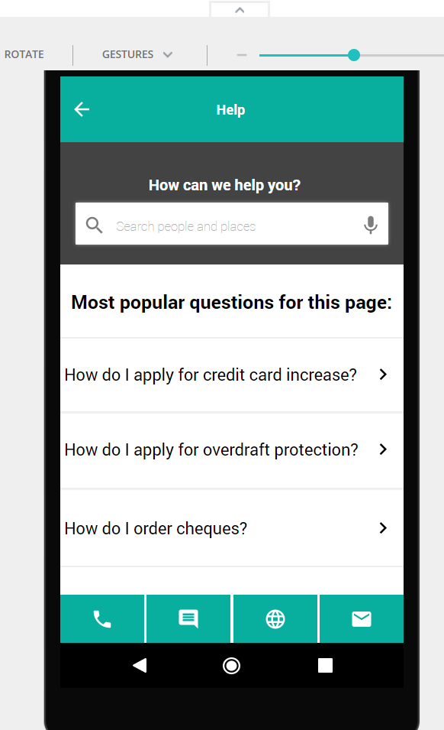
help page
In this screen the user can view the frequently asked questions on the app and can also contact customer support for additional help.

Slide 11
Examples of Low fidelity and High fidelity

Slide 12
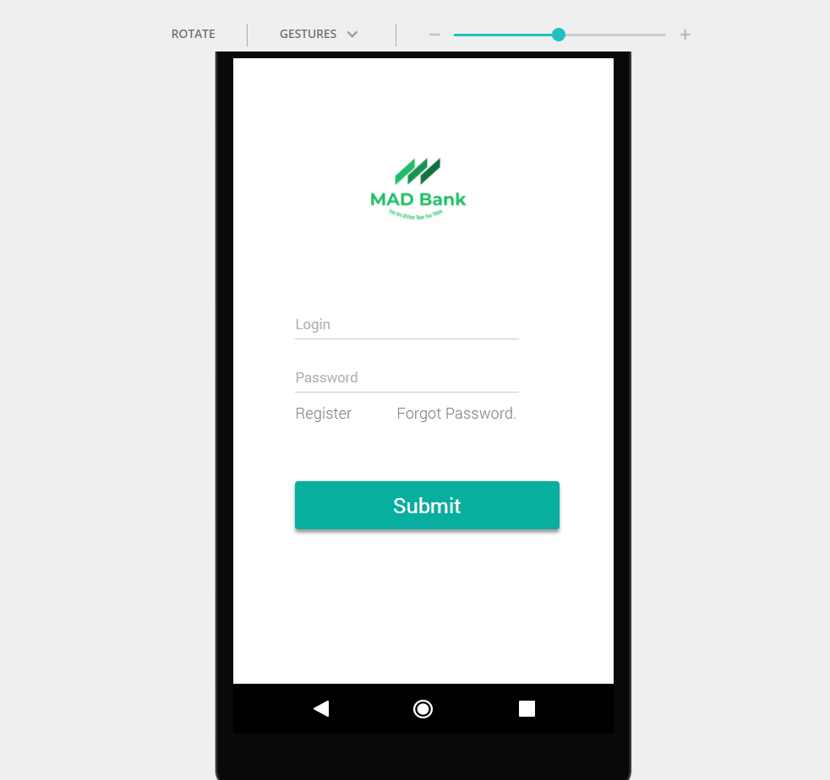
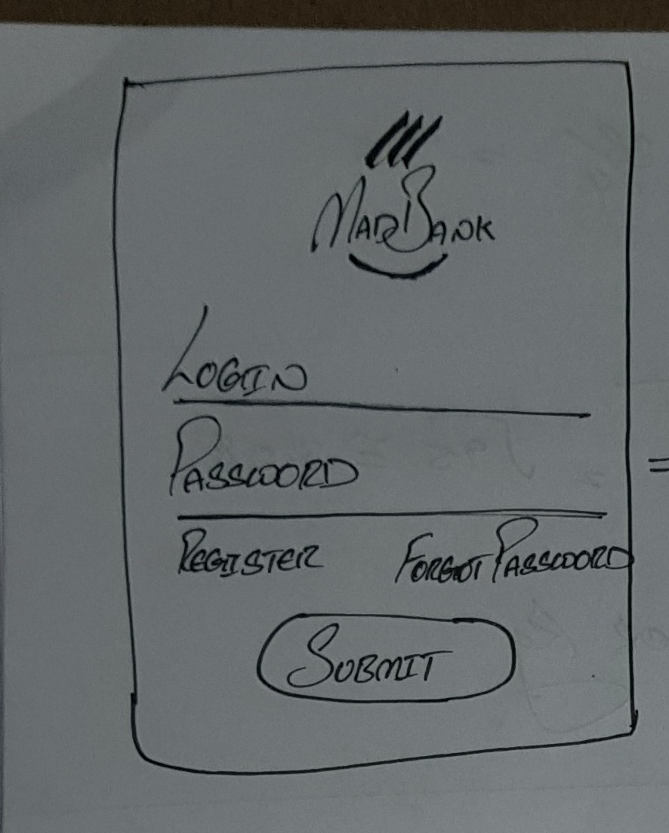
Low fidelity and High fidelity
VS

Slide 13
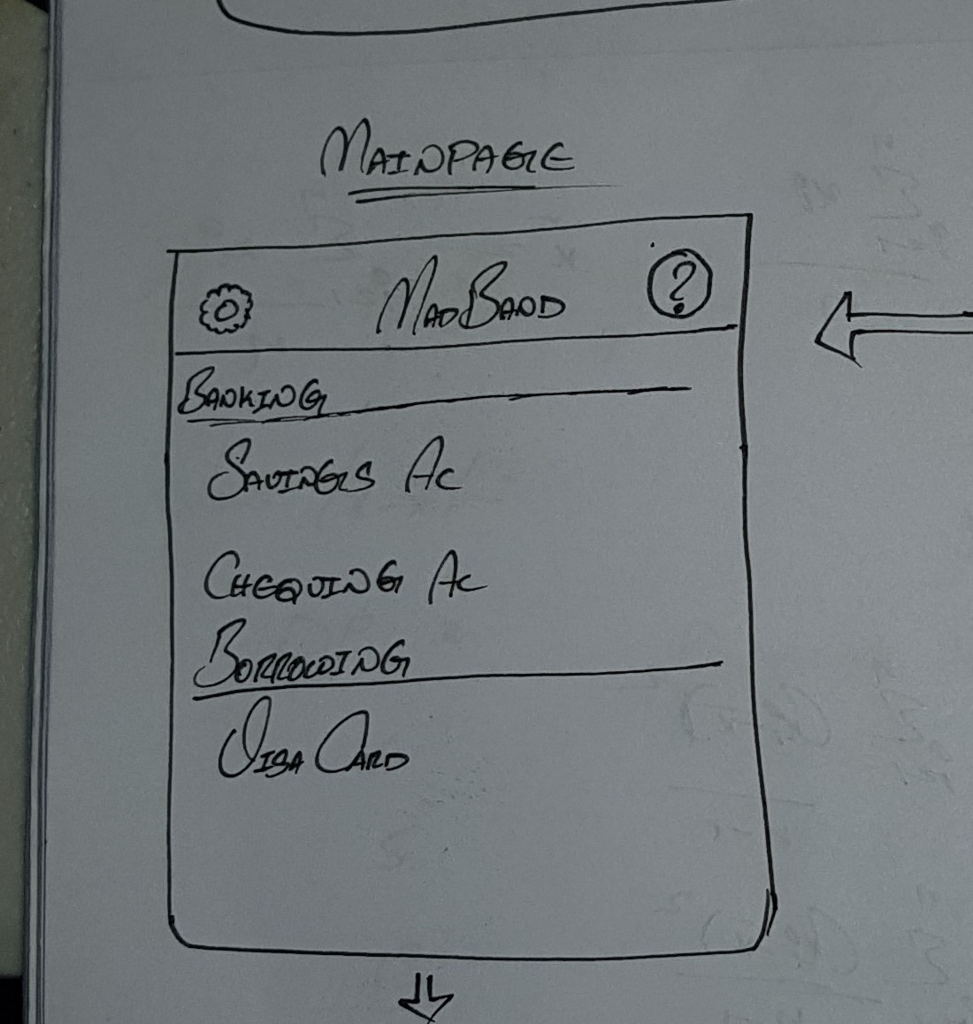
Low fidelity and High fidelity
VS

Slide 14
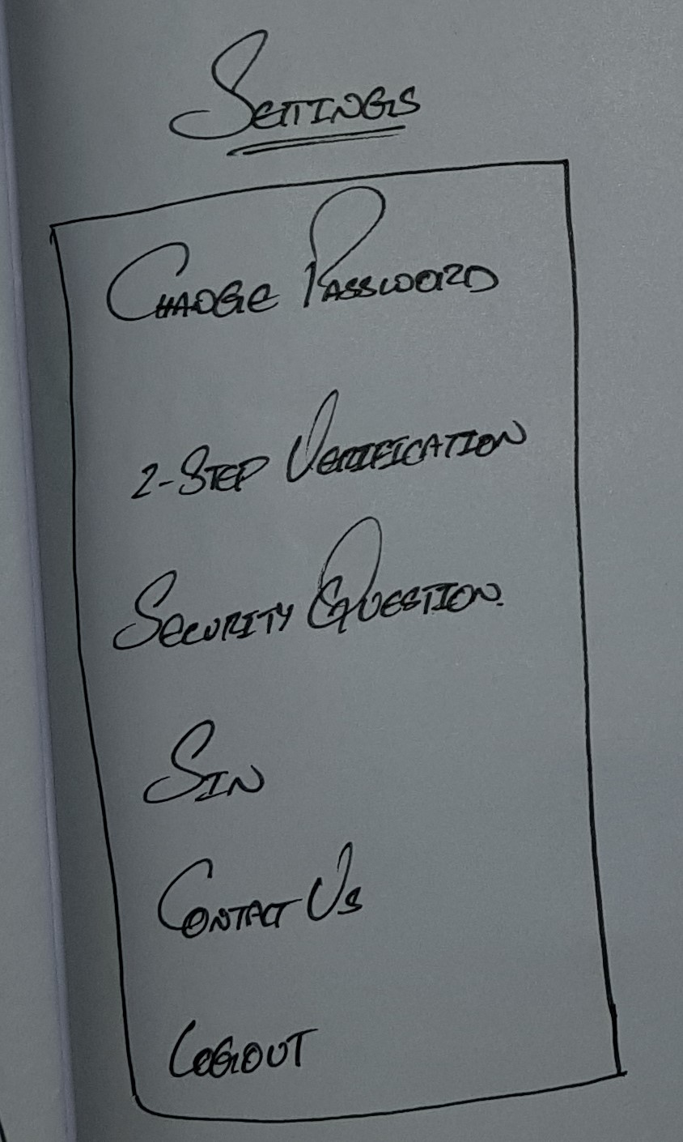
Low fidelity and High fidelity
VS

Slide 15
Question time

Slide 16
Thank you

